Slide 1
SCIT Project A Overview
Presented by: Edgar

Slide 2
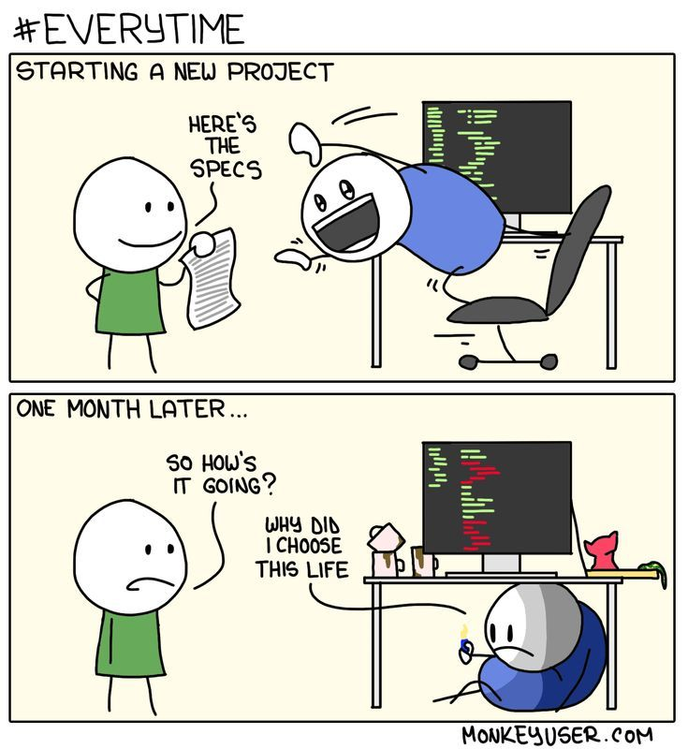

Slide 3
Pre-requisites
Research methods
Programming units
System Analysis and Design
software Development
Communication skills
Et. Al.

Slide 4


Slide 5
Unit Overview and Introduction
Projects is divided into two parts, that is Project A and project B.
For this semester, we will be working on project A. It entails proposal writing.
The proposal is written in future tense because this is what the learner intends to do in the future

Slide 6
Project A
In summary project A requires you to identify a project title.
The best way to identity project title is to first review your environment/the real world and spot a problem that can be solved using ICT.

Slide 7
Choosing a Project Title
Once you have settled on the problem to solve, then you can phrase this into a title which should be a solution to that problem for example..

Slide 8
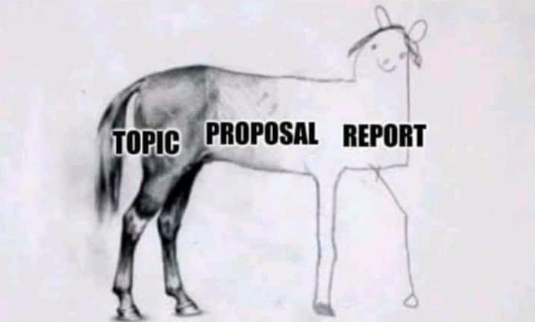

Slide 9
Example 1
You may have noticed there is a new Block in TUK and it will require network setup and configuration. So you can have a title like Enhanced LAN design for block S.

Slide 10
Example 2
You may also have noticed that most enterprises/people are moving towards use of solar powers a form of renewable energy.We don’t have an effective way of monitoring the small scale use of this technology. You may come up with an IoT solution that allows us to monitor harnessing and consumption of this solar power for small households.

Slide 11
Example 3
Due to the cover 19 pandemic, many learning institutions are re-engineering there traditional way of doing their routine tasks. You can decide to solve this problem by creating an integrated collaborative platform for a particular industry that allows for remote sharing of data and collaborative working.

Slide 12
Sections of Project A
Chapter 1:introduction
Chapter 2:Literature review
Chapter 3:Methodology
Chapter 4:System Analysis and Requirements modeling

Slide 13
Chapter 1: Introduction
This section consists of the following
Background of the Study
Problem Statement(s)
Objective: - (S - Specific, M - Measurable, A - Achievable, R- Realistic/Relevant, T- Time bound/boxed.
-general objective
-specific objective(s)
Justification
Scope of the Study
Limitations of the proposed system
Project Risk and Mitigation
Project Schedule
Budget and Resources

Slide 14
Chapter 2:Literature review
This consists of what has been done in the area of study; related work to your study and why you are not adopting or accepting their results for your study. Students are advised to use papers that are peer reviewed as they have validated solutions. Google Scholar is a valuable tool where you can get up to date works from different scholars. There should be in a chronological order and should not span more than 3 years (latest research). What the researcher intends to do to bridge the gap.
The literature review should not be just a compilation or reproduction of the works of others.
It requires the student to examine and comment critically on the literature relevant to thestudent’s project area or area of research.

Slide 15
Chapter 3:Methodology
The methodology chapter should describe a model/framework under which the system will be developed. It should address at least the following areas:-
The exact techniques used to collect facts and data
Tools used to analyze the data and the processes
Tools to implement and test the system
Time schedule and project cost
State the reasons for choosing the methodology.

Slide 16
Chapter 4:System Analysis and Requirements modeling
This chapter should address at least the following areas :-
Description on how the current system works using system analysis modelling tools such as flow charts, DFDs, Use cases, UML etc.
How the facts and the data gathered including the methods used
Requirement definitions and modelling of the current system and proposed system
Requirement definitions and specifications of the project

Slide 17
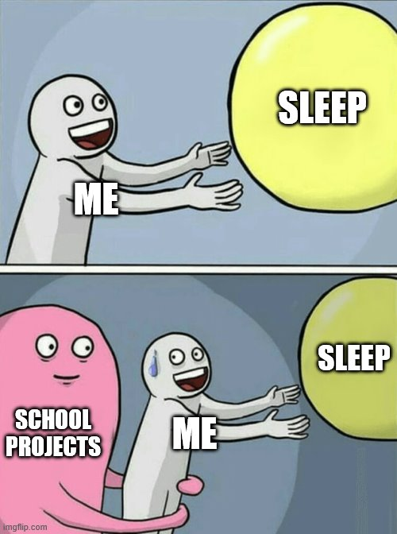

Slide 18
Deliverables
Project proposed titles(To be handed in by next week ,17/01/2023 by 11:59am, through a google form link that will be shared). MAX :15 WORDS.
Once title is approved, student will be assigned two supervisors whom the student is to immediately start liaising with. Every meeting between the student and the assigned supervisors will be recorded in a project Progress report log that is mandatory. Any comments from the supervisors will be filled therein

Slide 19
Deliverables cont….
At the end of the semester, the student will be required to make a presentation of Project A and submit documentation on the same. This will only be permitted if and only if the student is cleared by there supervisors.
After successful defense of the proposal, the student will proceed to project B.

Slide 20
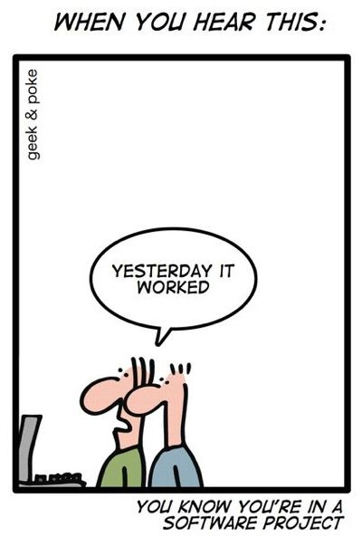

Slide 21
Grading
Your project proposal will be evaluated by a board of teachers to determine if the project idea is appropriate for a degree/diploma project or not. It is, therefore, important that you have listened to the feedback received at the presentations.
The purpose of the feedback is to make life easier for you, not to criticize.
Some ideas are simply not suitable for Academic projects.

Slide 22


Slide 23
Grading Cont….
You will get one of the following grades on your project proposal:
Pass – the project plan is okay and you can continue working on your project.
Minor revision – the project plan is overall okay but some minor things need to be fixed before you can start working on your project.
Major revision – the project plan is okay but some major things need to be fixed before you can start working on your project.
Fail – the project idea is not suitable for a degree/diploma project, or the project plan is of too low quality. In this case, you are not allowed to continue on the diploma/degree project course and have to start over the next semester.

Slide 24
Way forward
As mentioned earlier, this unit is examined from the very first class since it does not have sit in exams.

Slide 25
THANK YOU 謝謝

